Slide 1



Synthesizing Libraries of Programs with Auxiliary Functions
Habibur Rahman, Thirupathi Reddy, Kenneth Tjhia, Elham Parhizkar, Levi Lelis
March 2024
Notes:
Hello everyone!
Thank you very much for being here.
Today, I am going to present my thesis entitled by ….
the phrase “two irons in the fire.” … the main idea of our research. We are doing two things at the same time: Synthesizing libraries of program and solving problems.
… by optimizing the auxiliary function. … auxiliary function allows us to inject domain knowledge into system.
Let’s get started!

Slide 2

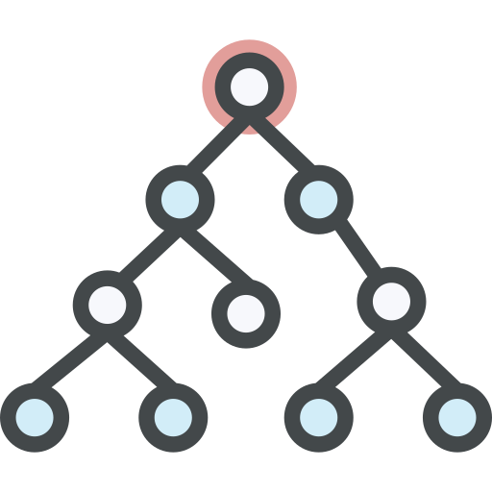



PROGRAM SYNTHESIS
Problem Specifications
Synthesizer
Search Space (Domain-Specific Language)
Program
* Icons from @flaticon
Notes:
… what is program synthesis is and what are the current state-of-the-art approaches.
… task of automatically finding a program that satisfies the user's intent.
How does a user express intent?
… various ways like logical specifications, input-output examples, natural language, partial programs, etc.
How do we define the search space?
… defined through a Domain-Specific Language (DSL).
So, the synthesizer needs the problem specification and the DSL to generate a program as output.

Slide 3
PROBLEM SPECIFICATIONS
INPUT
OUTPUT
…
Nancy FreeHafer
Andrew Cencici
…
938-242-5O4
244-655-O94
…
Honda125
Ducati125
…
9O.O
123
…
…
N. FreeHafer
A. Cencici
…
(938) 242 5O4
(244) 655 O94
…
Honda
Ducati
…
9O.OO
123.OO
…
Figure: String Manipulation Domain¹
¹Odena, Augustus, et al. "BUSTLE: Bottom-Up program synthesis through learning-guided exploration.", 2O2O.
Notes:
.. intents are expressed through input-output examples.
… tested our approach in two different domains: String Manipulation and Reverse Drawing.
In String Manipulation, we have input-output examples like …
in the Reverse Drawing domain, the input-output examples are images. …

Slide 4
DOMAIN-SPECIFIC LANGUAGE (DSL)
S → < | > | concat (S, S) | S.replace (S, S)
Figure: Sample Domain Specific Language (DSL) for String Manipulation
Notes:
A Domain-Specific Language defines the overall structure of the search space for programs.
… are represented using Context-Free Grammars (CFG).
… CFG and DSL interchangeably.
→ DSL Vs General Purpose Language (e.g, Python, C, C++, Java) etc
DSL → particular domain, GPL → across domain.
GPL → increase the search space → harder to find the solution.
→ On the left side of the slide, we have the DSL for String Manipulation.
"S" is the start symbol here. It can be extended as "S -> <", "S -> >", "S -> Concat()", or "S -> replace()".
"Concat" will concatenate two strings. "Replace" will substitute one instance of "S" with another in the string "S".
Example…
→ On the right-hand side, we have the DSL for the Reverse Drawing domain. Here, "S" can be extended as "S -> Forward(L, O)", and so on.
"Forward(L, O)" moves the pen by "L" pixels and, at the end, rotates left by "O" degrees from its current direction.
"Repeat(S, T)" is for repeating the program "S" "T" times.
"S.S" is for concatenating two programs.
"PenUp(S)" moves the pen by "S" pixels without drawing anything on the canvas.
Example …

Slide 5
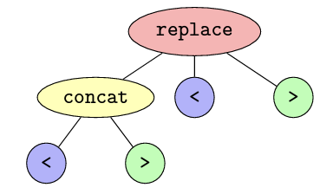
ABSTRACT SYNTAX TREE (AST)
Figure: AST of ’replace ( concat ( < , > ), < , > )’
Notes:
So, how can we visualize the programs?
→ visualized by a tree data structure, named as Abstract Syntax Tree (AST).
Every node signifies a production rule, while leaf nodes denote terminals.
size of a program → the number of nodes in its AST.
For example, on the left side, → program size is six, as its AST comprises six nodes.
Similarly, on the right → program's size is five because its AST contains only five nodes.

Slide 6
BOTTOM-UP SEARCH SYNTHESIS
S → < | > | concat (S, S) | S.replace (S, S)
Sample DSL for String Manipulation
Iteration # | Programs
1 | <, >
2 | ɸ
3 | concat(<, <), concat(<, >), concat(>, <), concat(>, >)
4 | ɸ
5 | concat(concat(<, <), , <),…, <.replace(<,<), <.replace(<,>), <.replace(>,<), <.replace(>,>),…
¹Aws Albarghouthi, Sumit Gulwani, Zachary Kincaid, Recursive Program Synthesis, 2O13. ²Abhishek Udupa, Arun Raghavan, Jyotirmoy V. Deshmukh, Sela Mador-Haim, Milo M.K. Martin, Rajeev Alur, TRANSIT: Specifying Protocols with Concolic Snippets, 2O13
Notes:
→ enumerates all possible programs in the search space.
→ brute-force algorithm that guarantees finding the solution if it exists.
Initially → initializes its set of programs with the terminal symbols of the language.
[Go through the example …]
→ generated programs are complete programs, that is none of those programs has any non-terminals.

Slide 7



BUSTLE¹
Cost Function
is the likelihood from model
replace ( concat ( < , > ), < , > )
¹Odena, Augustus, et al. "BUSTLE: Bottom-Up program synthesis through learning-guided exploration.", 2O2O.
Notes:
→ Cost Guided Bottom-up search
→ uses a neural network model to compute the likelihood of a problem being part of solution and accumulate that into the cost function
[describe for the terms and then example]
P1: concat ( < , > ) → Cost 4 → Lkhd → 0.65 ⇒ Bin: 5 → del 5-5 ⇒ 0
P2: < → Cost 12 → Lkhd → 0.21 → Bin: 2 ⇒ del 5 - 2 ⇒ 3
P3: > → Cost 13 → Lkhd → 0.15 → Bin: 1 ⇒ del 5 - 1 ⇒ 4
Total Cost: 1 + (4 + 0) + (12 + 3) + (13 + 4) = 37 Giving the random example

Slide 8
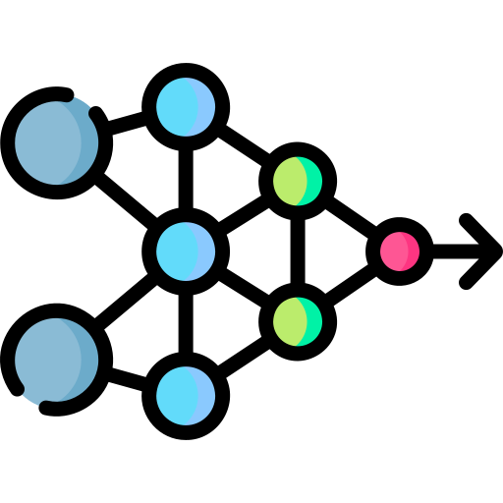
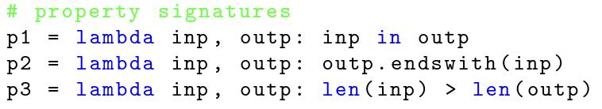
BUSTLE¹
Neural Network Model
Program: replace ( concat ( < , > ), < , > )
Inputs, I: “<<>”, “>><”
Outputs, O: “>><<>”, “>><<”
Program Output, V: “>>”, “>>”
Inputs (I) → Outputs (O):
Program Output (V) → Outputs (O):
[ 1, O, -1 , -1, -1, -1]
0.1
[ AllTrue, Mixed, AllFalse ]
[ 1, O, -1 ]
Concatenation
[ AllFalse, AllFalse, AllFalse ]
[ -1, -1, -1]
¹Odena, Augustus, et al. "BUSTLE: Bottom-Up program synthesis through learning-guided exploration.", 2O2O.
Notes:
→ neural network model play the role?
[Describe the example]
→ Training was done by synthetically generating data. [go to next page]
Generated random input strings.
And then from those inputs run BUS using a dummy output.
From those generated programs, selected random programs,
takes their outputs as output and some of their subprograms a intermediate program,
to keep balance, they also selected some random programs which are not subprograms
And, train the model.

Slide 9
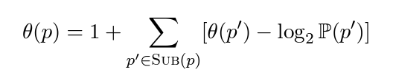
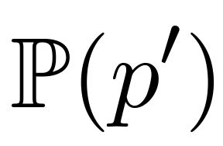
BEE SEARCH¹
Cost Function
is the likelihood from model
¹Saqib Ameen and Levi H.S. Lelis. Program synthesis with best-first bottom-up search. Journal of Artificial Intelligence Research , 2O23.
Notes:
Bustle → rounds off the cost of programs by using a delta function.
limitation of Bustle → actual order of programs does not necessarily reflect the true order of the associated costs.
Bee → orders the program of their true cost.
Bee → It penalizes the cost of the program by negative likelihood -log₂P(p′) instead of binning scheme
- log2(O.1) = 3.321928O9489
- log2(O.99) = O.O1449956969

Slide 10
CROSSBEAM¹
Keeps all generated programs in memory like BUS, BUSTLE and Bee Search.
Uses trained neural network model to create the probability distribution over the existing programs
Samples subprograms from the existing sets to generate next programs.
Use Beam Search or UniqueRandomizer² for sampling
concat ( < , > ) | replace ( < , > ) | … | < | > | …
O.56 | O.12 | ... | O.1 | O.O5 | …
replace(
,
,
)
¹Kensen Shi,Hanjun Dai,Kevin Ellis,and Charles Sutton. Crossbeam:Learning to search in bottom-up program synthesis.arXiv preprint arXiv:22O3.1O452, 2O22.
²Kensen Shi,David Bieber,and Charles Sutton. Incremental sampling without replacement for sequence models. In ICML,volume 119 of Proceedings of Machine Learning Research,pages 8785–8795.PMLR,2O2Ob.
Notes:
READ the slide →

Slide 11

AUXILIARY-BASED LIBRARY LEARNING (AULILE)
Learn library for a specific Problem
Learn and solve the problem at the same time
OUR APPROACH
Notes:
Now, here comes our approach.
DreamCoder, LAPS and Hernandez → learns the library of programs for the whole domain. We → learn library of programs only for a specific problem.
We → Learn and solve the problem at the same time.

Slide 12
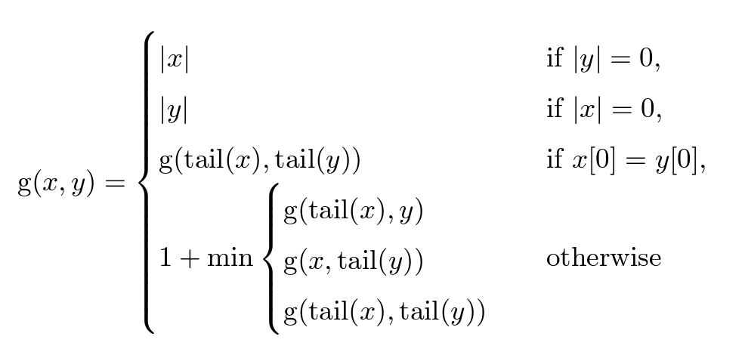
AUXILIARY-BASED LIBRARY LEARNING (AULILE)
S → < | > | concat (S, S) | S.replace (S, S)
Problem Specifications
Domain Specific Language
Auxiliary Function
Base Synthesizer
Learn library for a specific Problem not the whole domain
Learn and solve the problem at the same time
* Icons from @flaticon
Notes:
We need:
Problem Specification
DSL
Domain Dependant Auxiliary Function
Any Base synthesizer

Slide 13
RUNNING EXAMPLE OF AULILE
DSL
S → < | > | concat (S, S) | S.replace (S, S)
Input | Output
801-456-8765 <978> 654-0299 978.654.0299 | 8014568765 9786540299 9786540299
Notes:
Now, let's consider this running example.

Slide 14
RUNNING EXAMPLE OF AULILE
DSL
PROGRAM LIBRARY
S → < | > | concat (S, S) | S.replace (S, S)

Slide 15
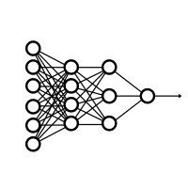
RUNNING EXAMPLE OF AULILE
DSL
PROGRAM LIBRARY
BASE SYNTHESIZER
S → < | > | concat (S, S) | S.replace (S, S)

Slide 16
RUNNING EXAMPLE OF AULILE
DSL
PROGRAM LIBRARY
BASE SYNTHESIZER
AUXILIARY FUNCTION
S → < | > | concat (S, S) | S.replace (S, S)
Input
801-456-8765 <978> 654-0299 978.654.0299
Program Output
8014568765 <9786540299 9786540299
Output
8014568765 9786540299 9786540299
P1(arg):
arg.replace("-", "")
.replace(".", "")
.replace(
concat(">", " "), "")

Slide 17
RUNNING EXAMPLE OF AULILE
DSL
PROGRAM LIBRARY
BASE SYNTHESIZER
AUXILIARY FUNCTION
…
HeapQueue …
Score
Program Size
Program String
…
S → < | > | concat (S, S) | S.replace (S, S)
RANKER
Input
801-456-8765 <978> 654-0299 978.654.0299
Program Output
8014568765 <9786540299 9786540299
Output
8014568765 9786540299 9786540299

Slide 18
RUNNING EXAMPLE OF AULILE
DSL
PROGRAM LIBRARY
BASE SYNTHESIZER
AUXILIARY FUNCTION
…
HeapQueue …
Score
Program Size
Program String
…
S → < | > | concat (S, S) | S.replace (S, S)
RANKER
SELECTOR
Input
801-456-8765 <978> 654-0299 978.654.0299
Program Output
8014568765 <9786540299 9786540299
P1
BEST PROGRAM
Output
8014568765 9786540299 9786540299

Slide 19
RUNNING EXAMPLE OF AULILE
DSL
PROGRAM LIBRARY
BASE SYNTHESIZER
AUXILIARY FUNCTION
…
HeapQueue …
Score
Program Size
Program String
…
S → < | > | concat (S, S) | S.replace (S, S)
RANKER
SELECTOR
Input
801-456-8765 <978> 654-0299 978.654.0299
Program Output
8014568765 <9786540299 9786540299
P1
BEST PROGRAM
Output
8014568765 9786540299 9786540299
Augmentation
P1

Slide 20
RUNNING EXAMPLE OF AULILE
DSL
PROGRAM LIBRARY
S → < | > | concat (S, S) | S.replace (S, S)
P1(arg):
arg.replace("-", "")
.replace(".", "")
.replace(
concat(">", " "), "")

Slide 21
RUNNING EXAMPLE OF AGS
DSL
PROGRAM LIBRARY
BASE SYNTHESIZER
S → < | > | concat (S, S) | S.replace (S, S)
P1(arg):
arg.replace("-", "")
.replace(".", "")
.replace(
concat(">", " "), "")

Slide 22
RUNNING EXAMPLE OF AULILE
DSL
PROGRAM LIBRARY
BASE SYNTHESIZER
AUXILIARY FUNCTION
S → < | > | concat (S, S) | S.replace (S, S)
P1(arg):
arg.replace("-", "")
.replace(".", "")
.replace(
concat(">", " "), "")
Input
801-456-8765 <978> 654-0299 978.654.0299
Program Output
8014568765 9786540299 9786540299
Output
8014568765 9786540299 9786540299
P2(arg):
P1(arg)
.replace("<", "")

Slide 23
RUNNING EXAMPLE OF AULILE
DSL
PROGRAM LIBRARY
BASE SYNTHESIZER
AUXILIARY FUNCTION
…
HeapQueue …
Score
Program Size
Program String
…
S → < | > | concat (S, S) | S.replace (S, S)
P1(arg):
arg.replace("-", "")
.replace(".", "")
.replace(
concat(">", " "), "")
RANKER
Input
801-456-8765 <978> 654-0299 978.654.0299
Program Output
8014568765 9786540299 9786540299
Output
8014568765 9786540299 9786540299
P2(arg):
P1(arg)
.replace("<", "")

Slide 24
RUNNING EXAMPLE OF AULILE
DSL
PROGRAM LIBRARY
BASE SYNTHESIZER
AUXILIARY FUNCTION
…
HeapQueue …
Score
Program Size
Program String
…
S → < | > | concat (S, S) | S.replace (S, S)
P1(arg):
arg.replace("-", "")
.replace(".", "")
.replace(
concat(">", " "), "")
RANKER
SELECTOR
Input
801-456-8765 <978> 654-0299 978.654.0299
SOLUTION
P2
Program Output
8014568765 9786540299 9786540299
P2
P1
Output
8014568765 9786540299 9786540299

Slide 25

A-BUS, A-BUSTLE, A-BEE & A-CROSSBEAM
A-BUS, A-BUSTLE, A-BEE
Added the program as a non-terminal symbol
Cost is considered as 1
A-CROSSBEAM
In addition to adding the program, added random restart as it uses sampling to selected subprograms
To be clear the results, we evaluated restart both with original version and augmented version
If X is over all budget, and we want N restart, then we restarted after program evaluation
Notes:
What are A- X ?
→
READ SLIDE

Slide 26
DATASET
- SyGuS Benchmark¹
89 String Manipulation problems
Problems are string only
38 Benchmark²
More difficult problems
Less example pairs are given
Handcrafted
INPUT
OUTPUT
…
Nancy FreeHafer
Andrew Cencici
…
938-242-5O4
244-655-O94
…
Honda125
Ducati125
…
9O.O
123
…
…
N. FreeHafer
A. Cencici
…
(938) 242 5O4
(244) 655 O94
…
Honda
Ducati
…
9O.OO
123.OO
…
¹Rajeev Alur, Rastislav Bodik, Garvit Juniwal, Milo Martin, Mukund Raghothaman, Sanjit Seshia, RishabhSingh, Armando Solar-Lezama,Emina Torlak,and Abhishek Udupa. Syntax-guided synthesis.In 2O13 Formal Methods in Computer-Aided Design,FMCAD 2O13,pages 1–17,1O 2O13. doi:1O.11O9/FMCAD.2O13.6679385.
²Odena, Augustus, et al. "BUSTLE: Bottom-Up program synthesis through learning-guided exploration.", In ICLR, 2O21.
Notes:
[READ]

Slide 27
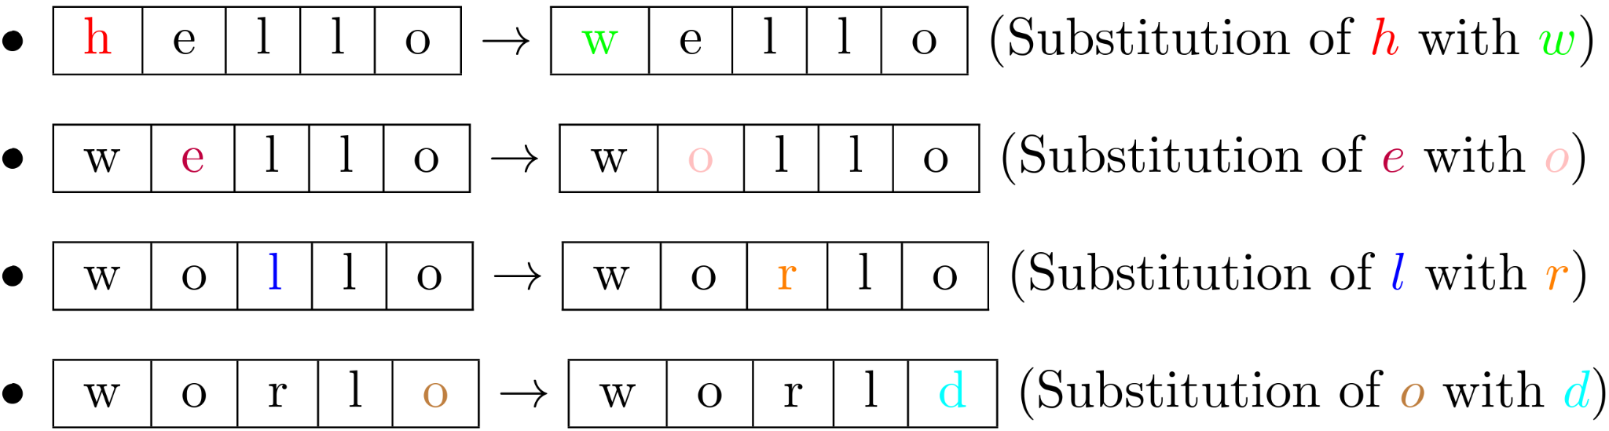
AUXILIARY FUNCTION
Measured string edit distance using Levenshtein distance¹
Minimum number of single-character edits (insert, delete or replace) required
¹Vladimir Levenshtein. Binary codes capable of correcting deletions, insertions,and reversals. In Soviet physics doklady, pages 7O7–71O. Soviet Union,1966.
Notes:
[READ]

Slide 28
EMPIRICAL RESULTS: FIRST SET
Notes:
In X axis, we have the number of program evaluated
In Y axis, we have the number of problem solved

Slide 29
EMPIRICAL RESULTS: SECOND SET
Notes:
In X axis, we have the running time in seconds
In Y axis, we have the number of problem solved
→ Need new dataset

Slide 30
EMPIRICAL RESULTS: THIRD SET
Notes:
In X axis, we have the running time in seconds
In Y axis, we have the number of problem solved
→ Need new dataset

Slide 31

* Icons from @flaticon

